Slide 1
MoMo Talent 2024 Data Analytics Trainee
Case Study
Candidate name: Bui Tuan Kiet
Candidate password: mt348ck4gj
Date: 16/06/2024

Slide 2
Part A: Data Processing
(10 points)

Slide 3
Part A
Question | Answer | Excel file data location (sheet/cell)
1) Total revenue in January 2020: | 1409827.02
2) Most profitable month: | 9/2020
3) Day of week (most money): | Wednesday
3) Day of week (least money): | Monday
4) Total number of New users in Dec 2020: | 72

Slide 4
Part B: Data Visualization
(10 points)

Slide 5
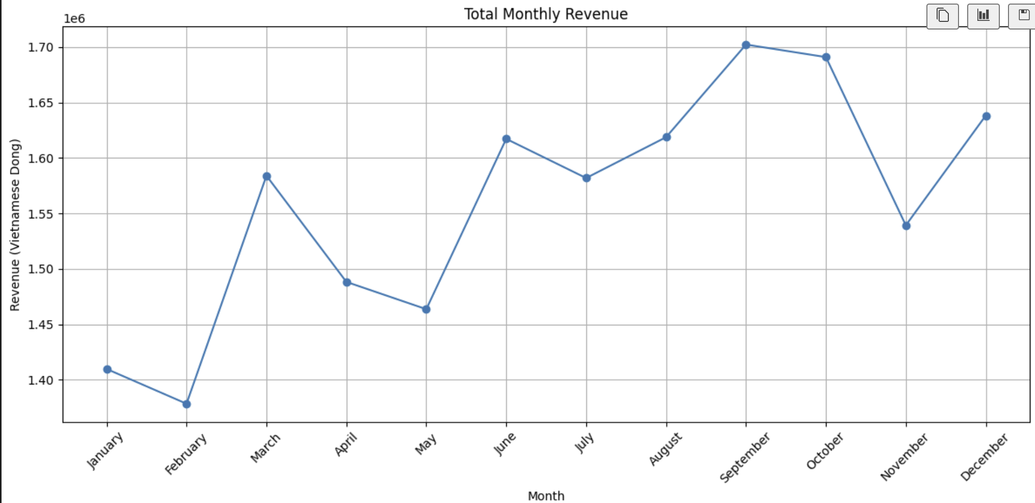
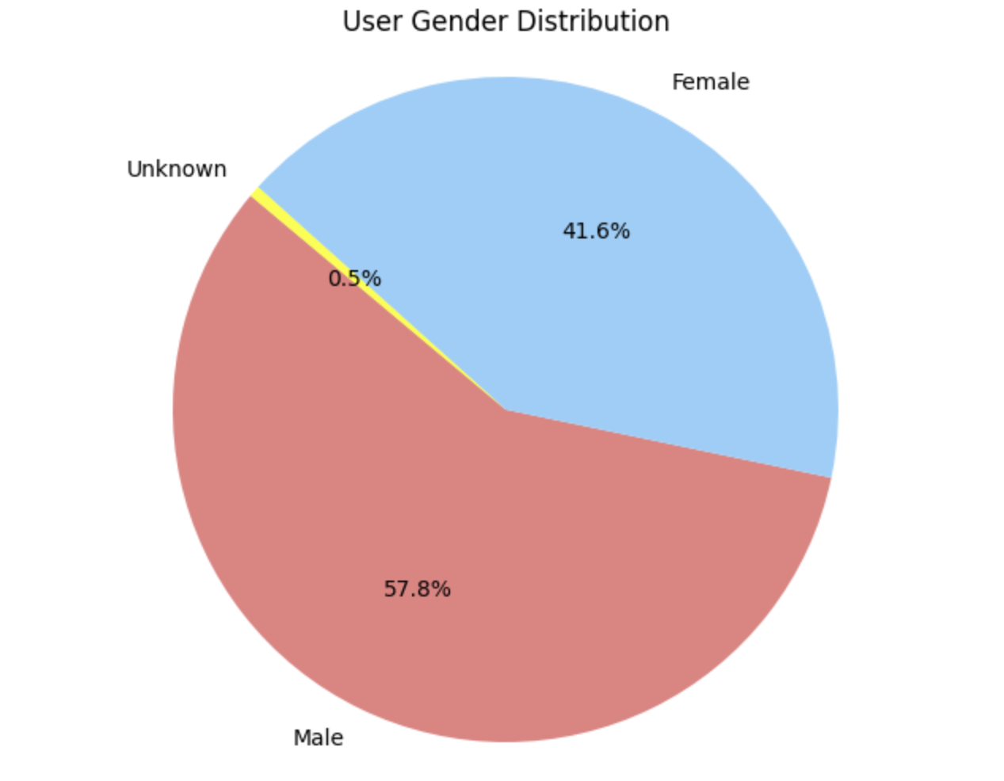
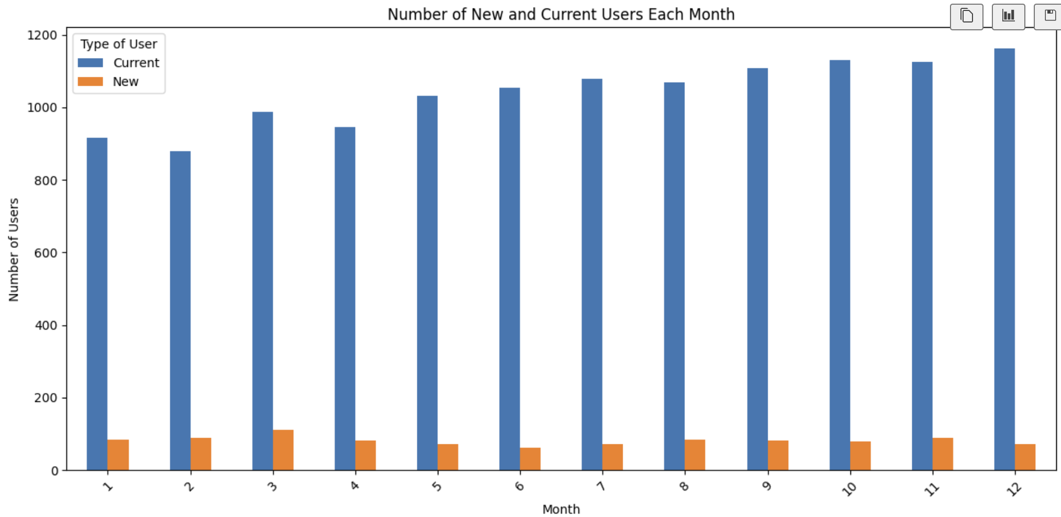
Part B: Q5: Performance Dashboard
[Maximum 2 slides]

Slide 6
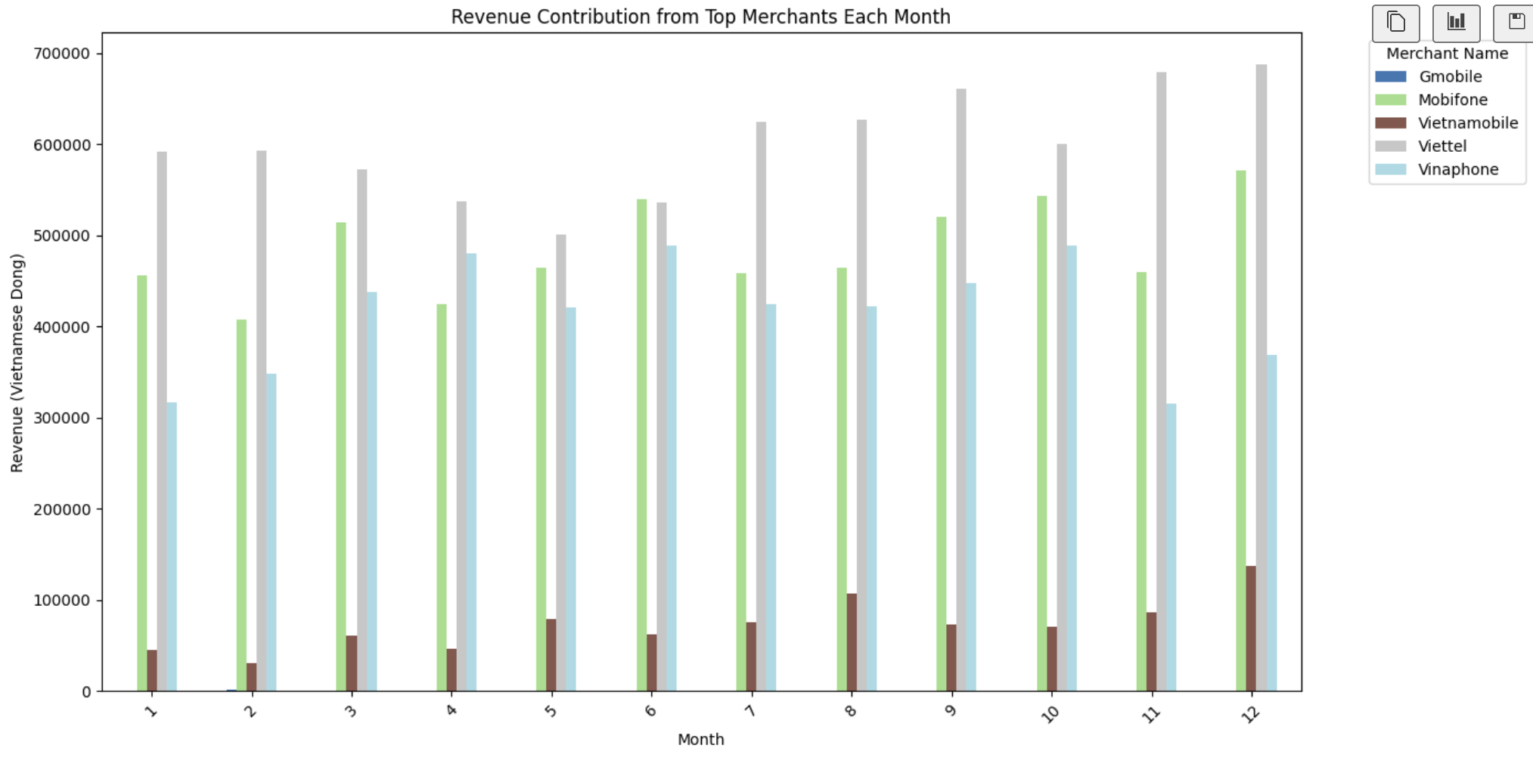
Part B: Q5: Performance Dashboard
[Maximum 2 slides]

Slide 7
Part C: Analysis & Business Insights
(10 points)

Slide 8
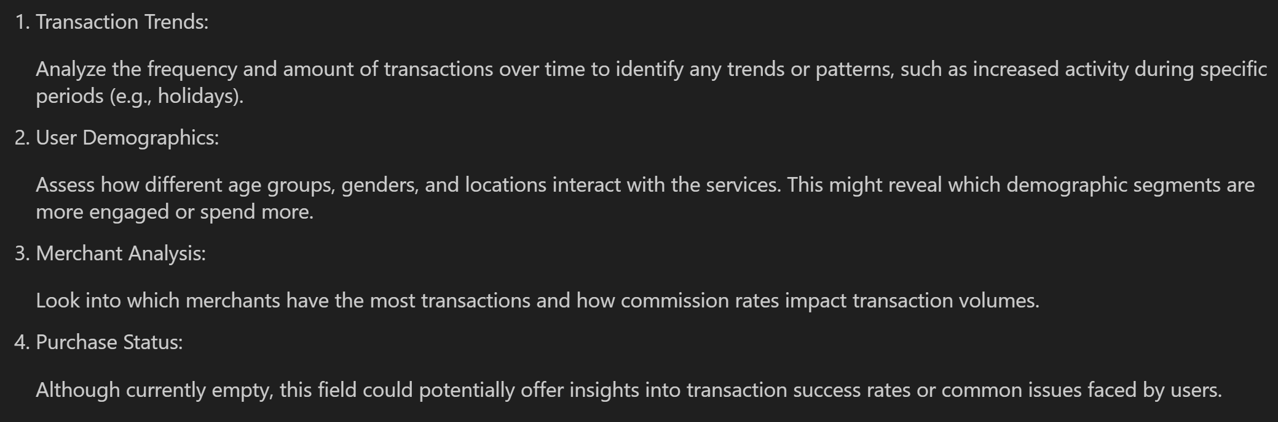
Part C: Q6

Slide 9
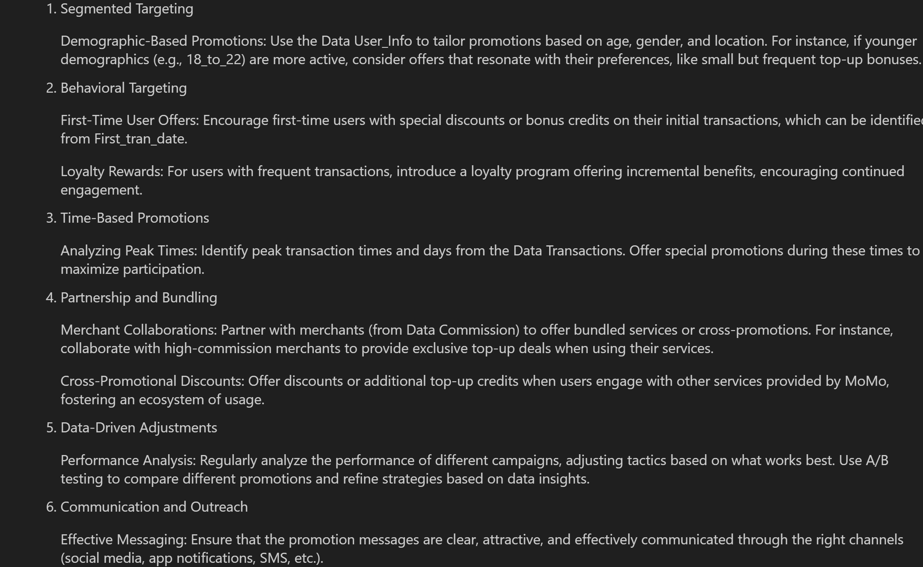
Part C: Q7

Slide 10
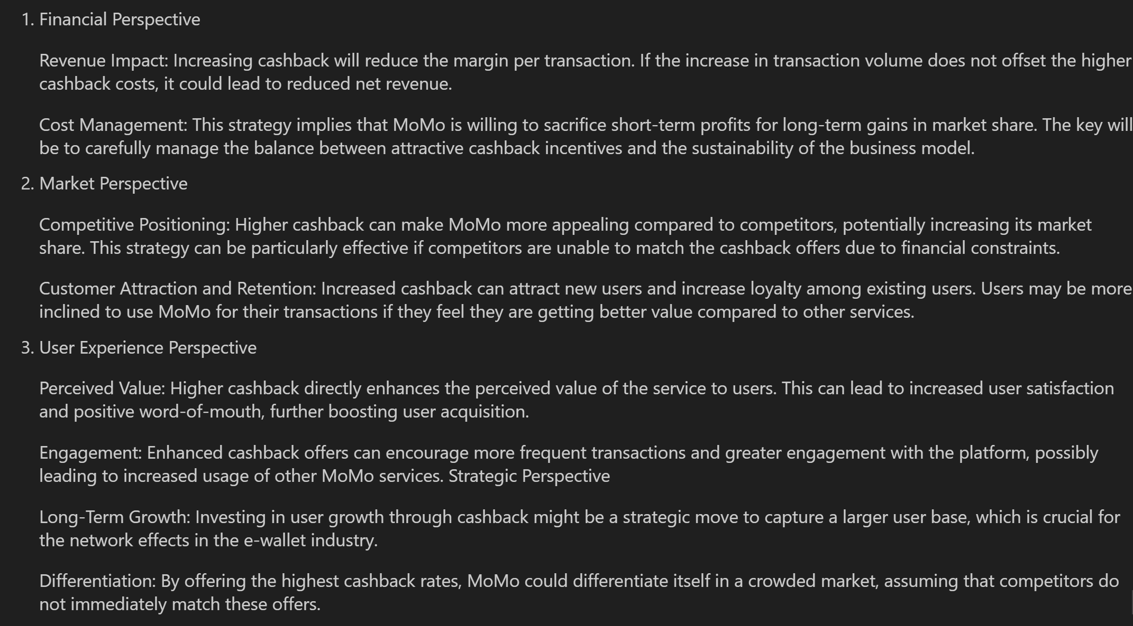
Part C: Q8

Slide 11
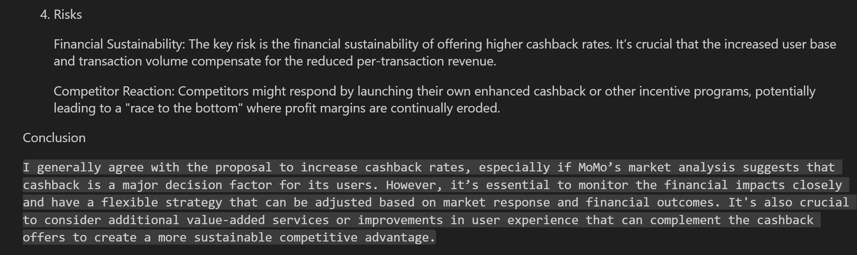
Part C: Q8

Slide 12
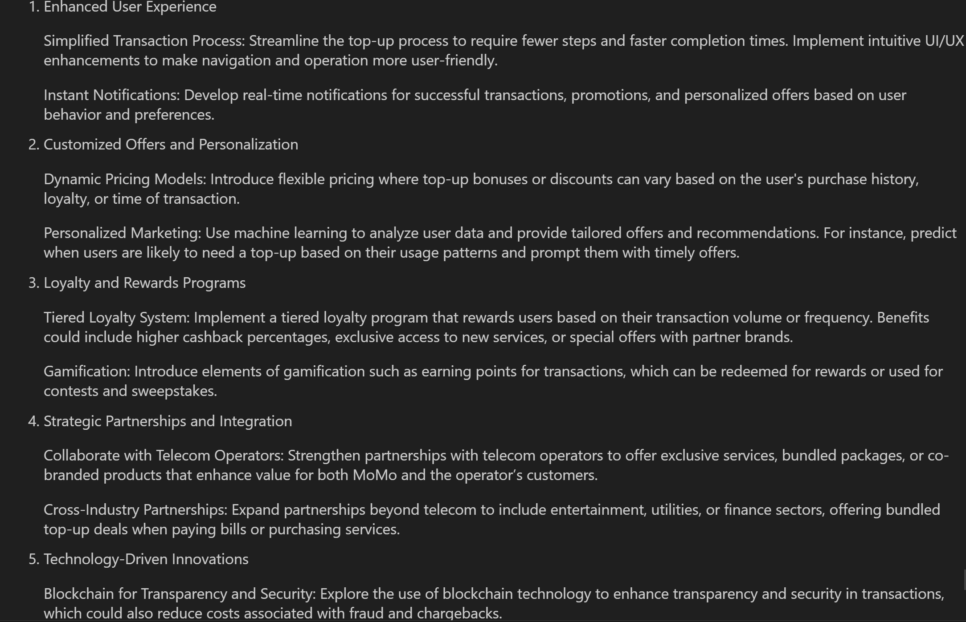
Part C: Q9

